Slide 1
CS 4530 & CS 5500
Software Engineering
Lecture 10.2: Continuous Integration
Jonathan Bell, John Boyland, Mitch Wand
Khoury College of Computer Sciences © 2021, released under CC BY-SA

Slide 2
Learning Objectives for this Lesson
By the end of this lesson, you should be able to…
Describe how continuous integration helps to catch errors sooner in the software lifecycle
Use continuous integration systems to automate testing in real software projects

Slide 3
Cost to Fix a Defect Over Time
Rough estimate
Old feedback loop: do this infrequently New feedback loop: do this continuously
Feedback loops we’ve covered: Requirements analysis, unit testing, code review
Notes:
Why expensive as move to the right?
Need to be triaged by someone who doesn’t know (or doesn’t remember)
Might now need more work, since code has changed around the bug
Has a greater impact - who wants to read about their bug on the front page of the newspaper?
This lesson: continuous integration. What kind of feedback loop can we put to find more bugs faster before deploying to production.
We’ve seen so far: The edit-compile-debug loop of local development, automated test results to a code change when you run it locally
Now consider:
An integration error between changes to two projects, detected after both are submitted and tested together (i.e., on post-submit) An incompatibility between our project and an upstream microservice dependency, detected by a QA tester in our staging environment, when the upstream service deploys its latest changes
Later this week we’ll consider:
Bug reports by internal users who are opted in to a feature before external users
Bug or outage reports by external users or the press

Slide 4
Continuous Integration
Motivation
Our systems involve many components, some of which might even be in different version control repositories
How does a developer get feedback on their (local) change?
Our changed code
My Social Network App
Cache Check
Build friends list
Build Newsfeed
Build Suggestions
Send response
Other developers’ changed code
Notes:
Continuous integration is particularly relevant in software that involves multiple components. A developer might change code in one component, say, the code that handles building the newsfeed that will show up in the returned page. This might live in one repo, and be an independent component. However, this component is part of a bigger, overall application, which consists of other components: the newsfeed probably depends on other components (like that which builds a friends list), and there might be other components that depend on the newsfeed (like something that builds a list of suggestions). There might be even more complex interactions with other components: like perhaps before sending a response back to a client, the server will save the response into a cache, and on repeated requests, that cache is served. There might be other changes going on, too - other developers are likely working on changing other components at the same time. Traditional waterfall or even agile development processes often involve performing integrations between all of these changes infrequently - perhaps weekly or monthly. The idea behind continuous integration is to integrate these changes and test them rapidly - as soon as they are created.

Slide 5
Continuous Integration
Continuously assembling and testing our entire codebase
0…………….
Develop
Build
Test
Deploy
Monitor
End-to-end Test
KPIs
Code Review
Style Check
Integration Test
Compile
Load Test
Unit Test
Prepare Deployment
Automate this centrally, provide a central record of results
Notes:
So, the core to continuous integration is to centrally and automatically execute these development processes, regularly. With CI, we continuously assemble and test changes to our codebase. By performing these integrations quickly and frequently, we can get faster feedback, and hence, “shift left” - allowing bugs to be detected sooner. There’s an enormous difference in how long it takes to debug something if you detect the bug immediately after writing the code versus even, say, the next day - let alone after several weeks.

Slide 6
Build Systems
Automatically compiling code and generating executables
You’ve probably used multiple of these:
Make, maven, ant, gradle, grunt, sbt
Why use a build system?
Builds should be repeatable
Builds should be reproducible
Builds should be standard
Notes:
CI calls for automatically compiling our code and running tests. This process relies on the presence of a well-configured build system.
By being repeatable, you ensure that that the project is built exactly the same way every time it builds no matter who “runs” the build or where it runs. This helps solve the “works on my machine” syndrome. By being reproducible allows you to take the build system and move/copy it to a different computer (or even a build server) or otherwise easily recreate (reproduce) the steps that are required to perform a build. Repeatable and reproducible really go hand-in-hand. By being standard, you ensure that all of your projects follow what the development team (and/or the industry) has defined as best practices.

Slide 7
Build Systems
Not just compilation
Fetch dependencies and link them (using a package manager like maven, pip or npm)
Provision & teardown resources for integration testing
Run tests
Generate a release archive
Ideally, do this all in parallel as much as possible

Slide 8
How do we apply continuous integration?
Testing the right things at the right time
Do we integrate changes immediately, or do a pre-commit test?
Which tests do we run when we integrate?
How do we compose the system under test at each point?
Changed code
My Social Network App
Cache Check
Build friends list
Build Newsfeed
Build Suggestions
Send response
Other developers’ changed code
Notes:
Immediately/pre-commit: small project with a few commits a day and a test suite under 30 mins, probably integrate immediately and run full test suite. But: consider our social network app, where we might have 20 changes/hour and a 30 mins test suite, when do you choose to integrate things? Do we wait for last integrated change to pass before integrating next?
Which tests to run - again, easy on small. But: what if our big social network app: we probably should also run tests that could depend on this (like other components of our request pipeline). At the limit: maybe now our new newsfeed change will impact how the request caching feature works, and we should check that too. Do we check everything?
How do we compose system under test - do we use mocks for external services, or do we use production, or do we make a special environment for each integration test?
We’ll look at a few examples

Slide 9

Continuous Integration in Practice
Small scale, with a service like CircleCI, GitHub Actions or TravisCI
GitHub
Commits code to
Checks for updates
Developer
GitHub Actions
TravisCI
CircleCI
Runs build for each commit
Notes:
Run an entire test suite on each commit

Slide 10
Continuous Integration in Practice
Large scale example: Google TAP
>50,000 unique changes per-day, > 4 billion test cases per-day
Pre-submit optimization: run fast tests for each individual change (before code review). If fast tests pass, allow the merge to continue
Then: run all affected tests; “build cop” monitors and acts immediately to roll-back or fix
Build cop monitors integration test runs
Average wait time to submit a change: 11 minutes
“Software Engineering at Google: Lessons Learned from Programming Over Time,” Wright, Winters and Manshreck, 2020 (O’Reilly)

Slide 11
Continuous Integration in Practice
Medium-scale example with branches
Git Branch | Continuous Integration Pipeline
Develop | lint | unit test
Staging | lint | unit test | integration test
Stable | lint | unit test | integration test | deploy

Slide 12
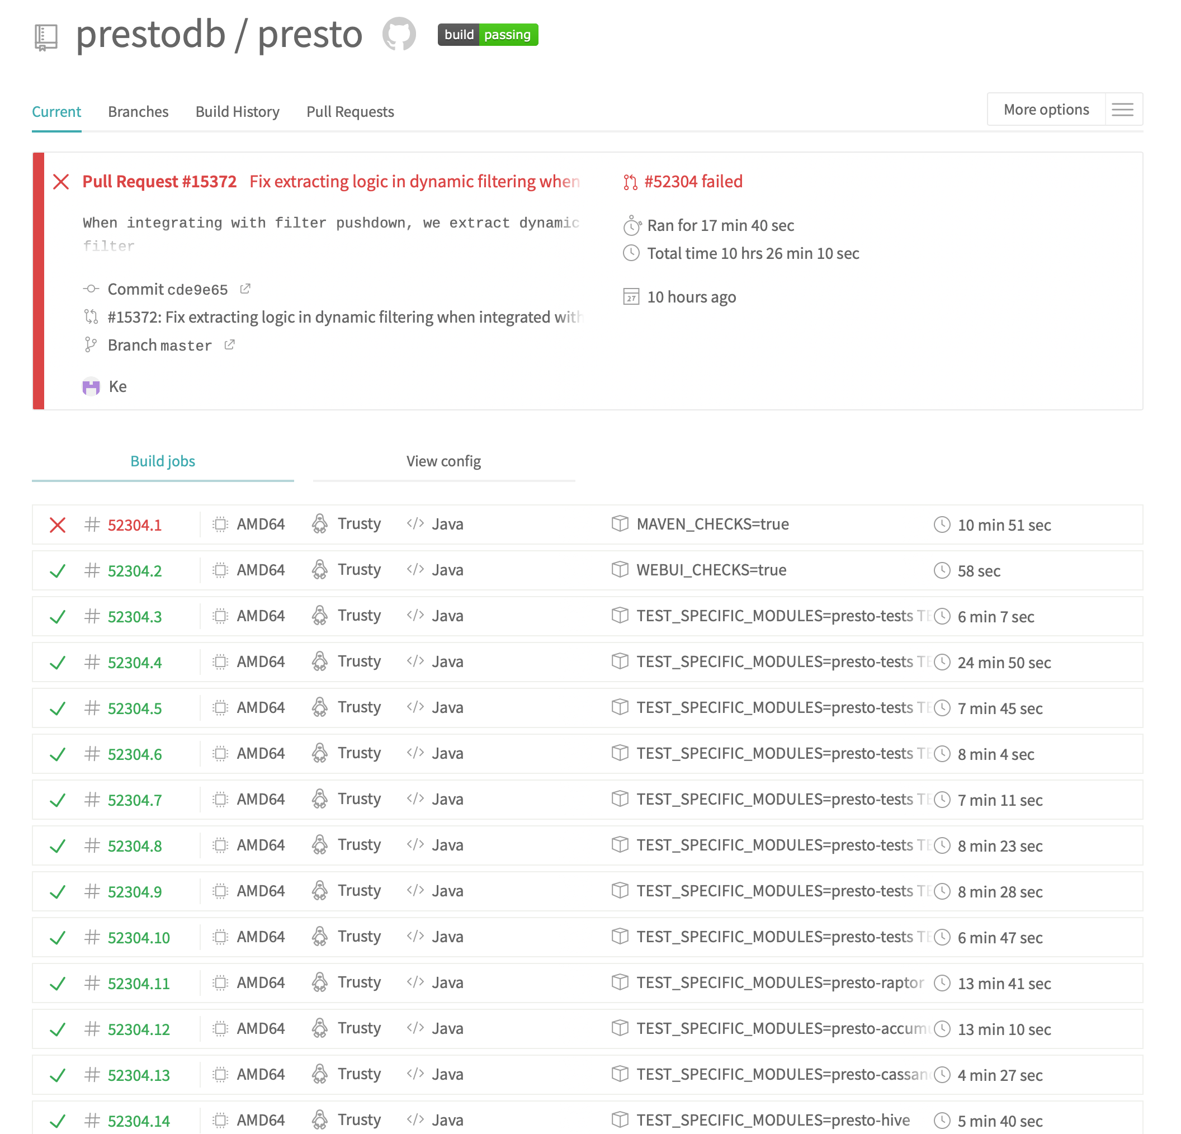
Example CI Pipeline
Open source project: PrestoDB
https://travis-ci.com/github/prestodb/presto
Notes:
Here’s a screenshot of a continuous integration pipeline from an open source project, Facebook’s presto database.
Point out: Run on pull request, runs multiple jobs

Slide 13
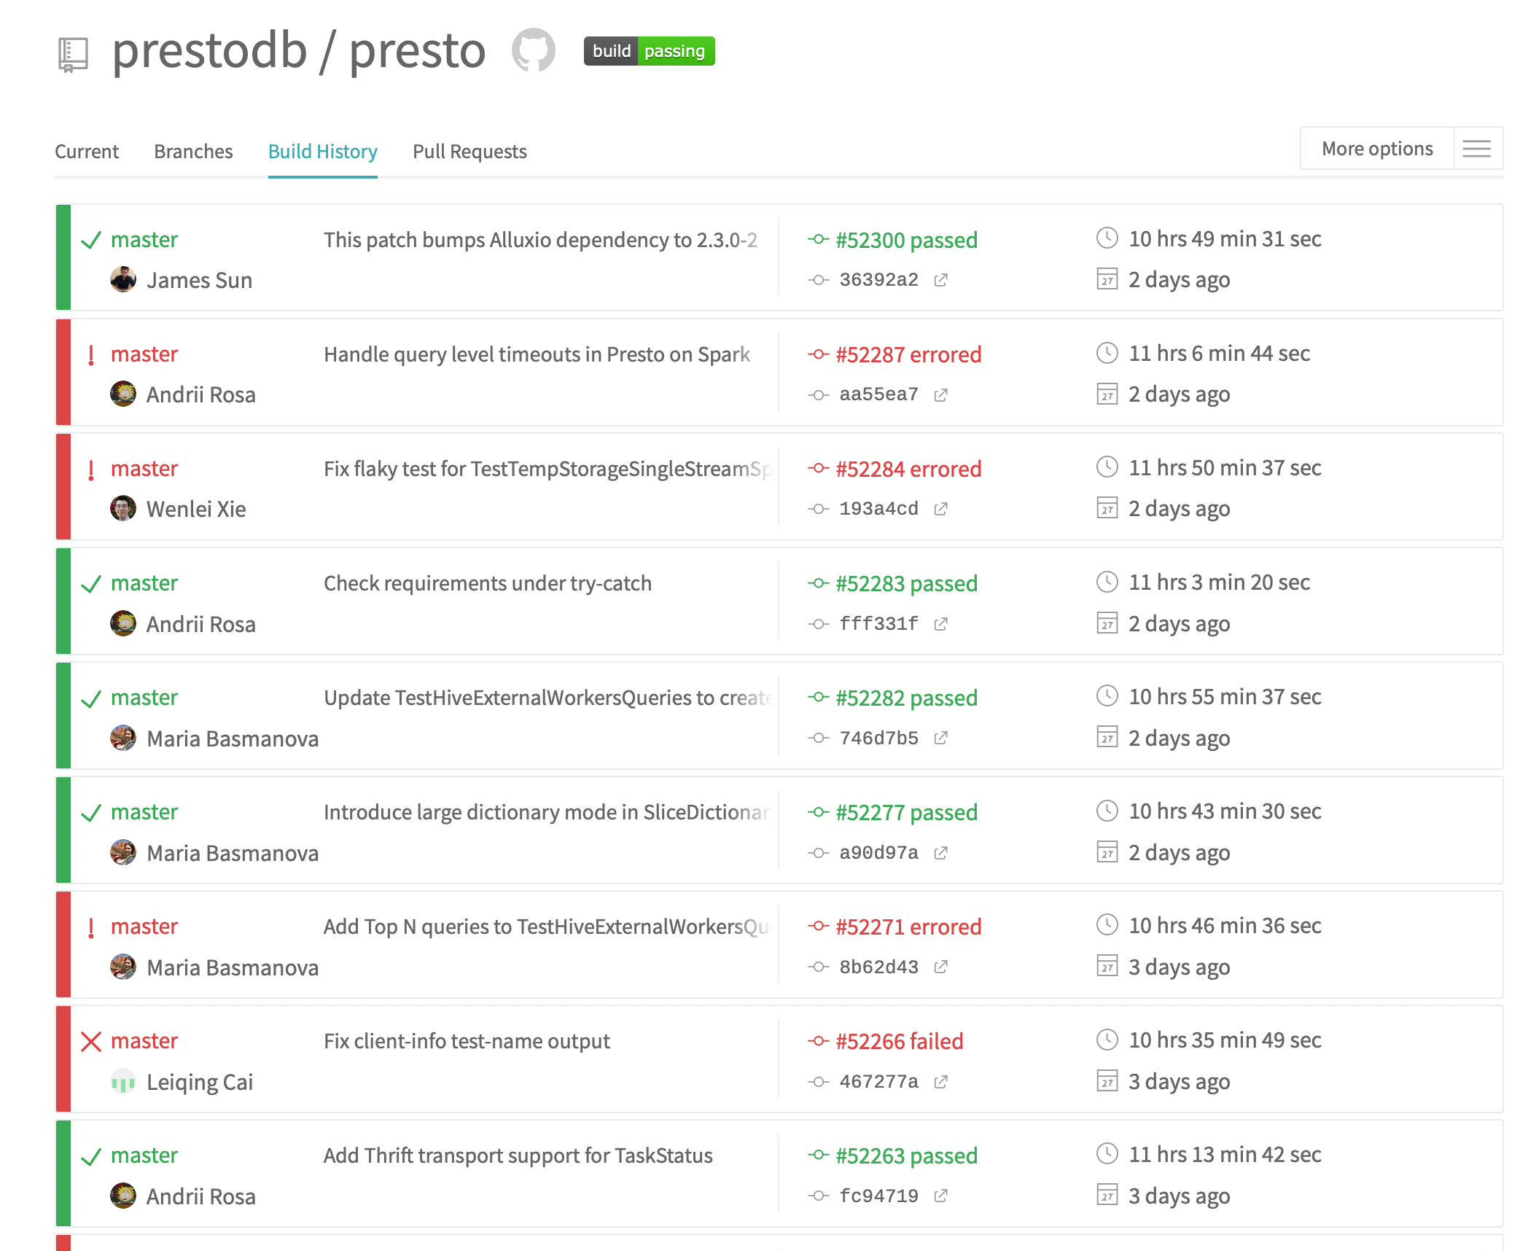
Example CI Pipeline - TravisCI
At a glance, see history of build
https://travis-ci.com/github/prestodb/presto
Notes:
Here’s another view of that same project’s CI pipeline: here we can see the history of each build. From this view, any developer can answer the simple question: “when did a test break? What fixed it?”

Slide 14
Continuous Integration
Summary and next steps
CI helps catch errors sooner in the software lifecycle by performing integration and end-to-end tests sooner
CI can be applied in small-scale projects by running complete test suites for each commit, or in larger projects by running pre-commit tests per-commit and complete integrations regularly
CI assumes the ability to automatically provision infrastructure on which to run those integration tests [next lesson]

Slide 15
This work is licensed under a Creative Commons Attribution-ShareAlike license
This work is licensed under the Creative Commons Attribution-ShareAlike 4.0 International License. To view a copy of this license, visit http://creativecommons.org/licenses/by-sa/4.0/
You are free to:
Share — copy and redistribute the material in any medium or format
Adapt — remix, transform, and build upon the material
for any purpose, even commercially.
Under the following terms:
Attribution — You must give appropriate credit, provide a link to the license, and indicate if changes were made. You may do so in any reasonable manner, but not in any way that suggests the licensor endorses you or your use.
ShareAlike — If you remix, transform, or build upon the material, you must distribute your contributions under the same license as the original.
No additional restrictions — You may not apply legal terms or technological measures that legally restrict others from doing anything the license permits.

